Slide 1

Final Presentation
Team Members: Apurwa Bhausaheb Sontakke, Vedant Wagh
Group Name - HealthData Innovators
Name – Apurwa Bhausaheb Sontakke
Email – sontakke.ap@northeastern.edu
Country - USA
College – Northeastern University
Specialization – Data Science
Date : 07/01/2024
GitHub repo link - https://github.com/apurwasontakke/Data-Science-Healthcare-Project--Final-Report-Presentation

Slide 2
Problem Description
Pharmaceutical companies face a significant challenge in understanding why patients continue or discontinue their prescribed medications. To address this, ABC Pharma has sought the help of an analytics company to automate the identification process of factors influencing drug persistency. The aim is to develop a classification model that predicts whether a patient will persist with a prescribed drug (Persistency_Flag).

Slide 3
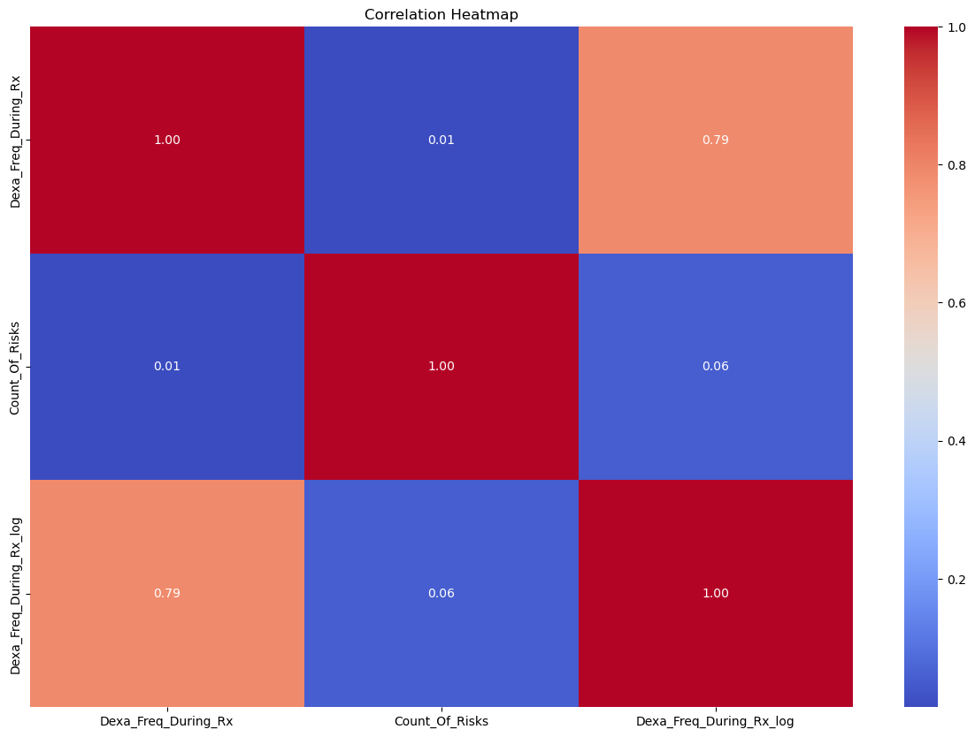
The correlation heatmap displays the strength and direction of relationships between numerical variables in the dataset. Each cell in the heatmap shows the correlation coefficient between two variables, with values ranging from -1 to 1.
Dexa_Freq_During_Rx and Dexa_Freq_During_Rx_log have a high positive correlation (0.79), indicating that the log transformation retains the relative order of values while reducing skewness.
Dexa_Freq_During_Rx and Count_Of_Risks have a very weak positive correlation (0.01), indicating little to no linear relationship.
Count_Of_Risks and Dexa_Freq_During_Rx_log also have a very weak positive correlation (0.06), similar to the original Dexa_Freq_During_Rx variable.

Slide 4
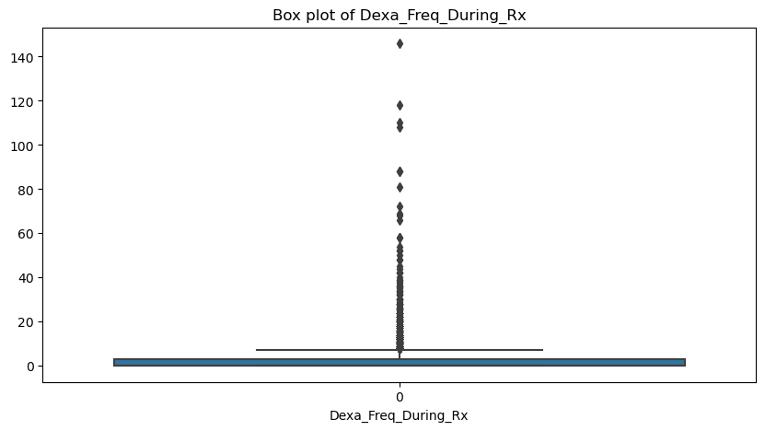
This box plot visualizes the distribution of the Dexa_Freq_During_Rx variable, highlighting the median, quartiles, and potential outliers.
Key Observations:
The majority of the data points for Dexa_Freq_During_Rx are concentrated near the lower end of the scale.
There are numerous outliers extending far beyond the upper quartile, indicating a right-skewed distribution with extreme values.

Slide 5
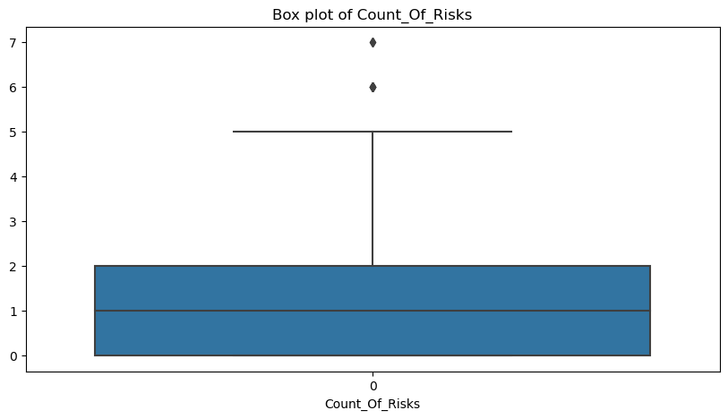
This box plot visualizes the distribution of the Count_Of_Risks variable, highlighting the median, quartiles, and potential outliers.
Key Observations:
The Count_Of_Risks variable has a more balanced distribution compared to Dexa_Freq_During_Rx.
The median value is 1, and the interquartile range (IQR) is between 0 and 2.
There are a few outliers beyond the upper whisker, indicating some higher risk counts that deviate from the typical range.

Slide 6
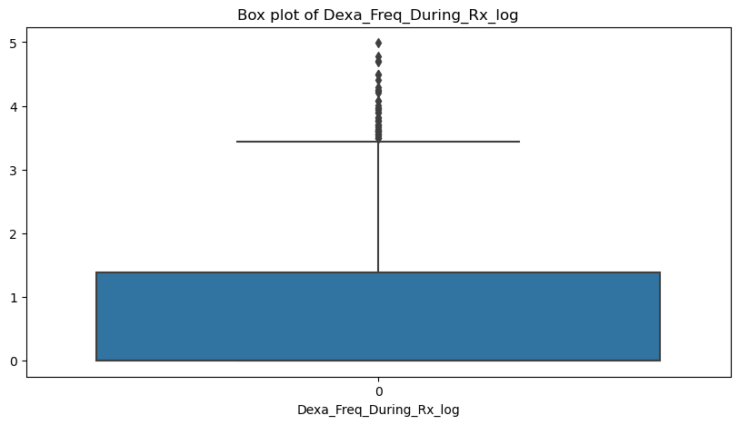
Description: This box plot visualizes the distribution of the log-transformed Dexa_Freq_During_Rx variable, highlighting the median, quartiles, and potential outliers.
Key Observations:
The log transformation reduces the skewness observed in the original data, but outliers are still present.
The majority of the data is concentrated below the 1 value, indicating a right-skewed distribution even after log transformation.

Slide 7
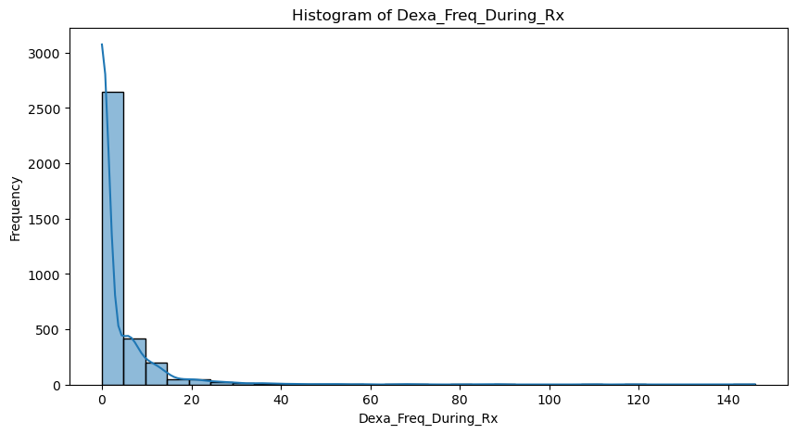
This histogram displays the distribution of the Dexa_Freq_During_Rx variable.
Key Observations:
The distribution is highly right-skewed, with most data points concentrated at the lower end.
There are a few extreme values extending up to 146, which are potential outliers.

Slide 8
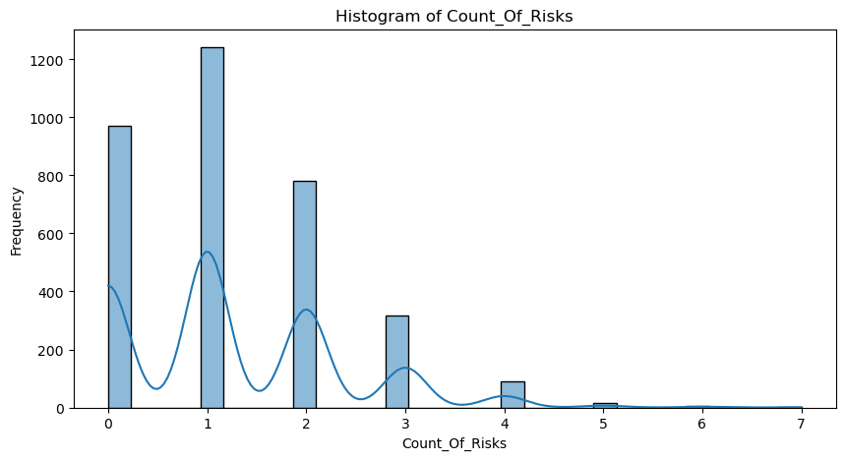
This histogram displays the distribution of the Count_Of_Risks variable.
Key Observations:
The distribution shows multiple peaks, indicating several common values within the dataset.
The majority of the data falls between 0 and 4, with fewer instances of higher risk counts.

Slide 9
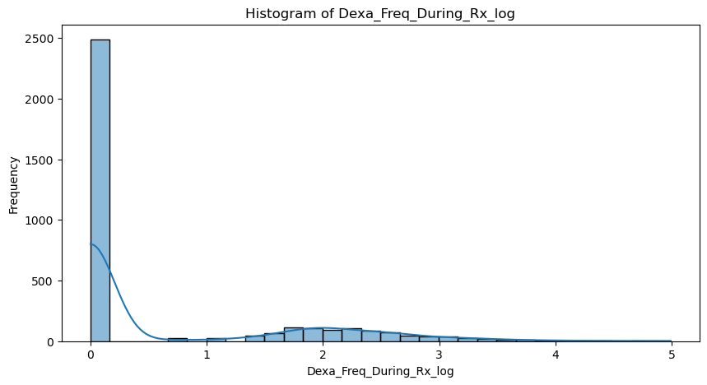
This histogram displays the distribution of the log-transformed Dexa_Freq_During_Rx variable.
Key Observations:
The log transformation has compressed the extreme values, making the distribution less skewed.
The majority of the data is still concentrated at the lower end, but the spread is more even compared to the original distribution.

Slide 10
This histogram displays the distribution of the Count_Of_Risks variable.
Key Observations:
The distribution shows multiple peaks, indicating several common values within the dataset.
The majority of the data falls between 0 and 4, with fewer instances of higher risk counts.

Slide 11
This histogram displays the distribution of the Count_Of_Risks variable.
Key Observations:
The distribution shows multiple peaks, indicating several common values within the dataset.
The majority of the data falls between 0 and 4, with fewer instances of higher risk counts.

Slide 12
Best Model for problem
Based on the performance analysis and the specific requirements of the problem, the Optimized Logistic Regression Model is the best choice to solve the problem of predicting drug persistency for ABC Pharma.
Strengths:
High Interpretability: Logistic Regression is highly interpretable, allowing stakeholders to understand and trust the model's predictions.
Balanced Performance: The optimized model provides a balanced performance with good precision and recall for both persistent and non-persistent cases.
Consistency: The model maintains a high level of accuracy and performs consistently across different metrics, ensuring reliable predictions.

Slide 13
Actionable Recommendations:
Focus on High-Risk Groups:
Develop targeted interventions for groups identified with higher risk of discontinuing medications.
Enhance Patient Engagement:
Implement programs to improve patient engagement and education, particularly for female patients who show higher non-persistency.
Monitor Outliers:
Pay attention to extreme cases and consider specialized support for patients with unusual patterns in medication usage.
Regular Review and Adjustment:
Regularly review patient data to identify new patterns and adjust strategies accordingly.
Gender-Specific Strategies:
Design gender-specific strategies to address the unique challenges faced by male and female patients.

Slide 14
TECHNICAL IMPLEMENTATION
Parameter Settings: Use C=0.1 and solver='liblinear' with max_iter set to ensure convergence.
Preprocessing: Ensure data is properly scaled using StandardScaler and handle categorical variables with OneHotEncoder.
Deployment: Integrate the optimized Logistic Regression model into the production environment, ensuring seamless integration with existing data pipelines.
Monitoring and Maintenance: Set up monitoring to track model performance over time and retrain periodically to maintain accuracy.

Slide 15
CONCLUSION
This project focused on developing a machine learning model to predict drug persistency for ABC Pharma. After conducting extensive Exploratory Data Analysis (EDA) and evaluating several models, we determined that the Optimized Logistic Regression model was the most suitable for this task. By deploying the optimized Logistic Regression model, ABC Pharma can effectively address the challenge of predicting drug persistency, thereby enhancing patient outcomes and achieving better business results. This project underscores the importance of combining data science with domain expertise to solve complex real-world problems.

Slide 16

a
Thank You

